Slide 1

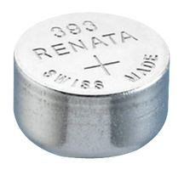

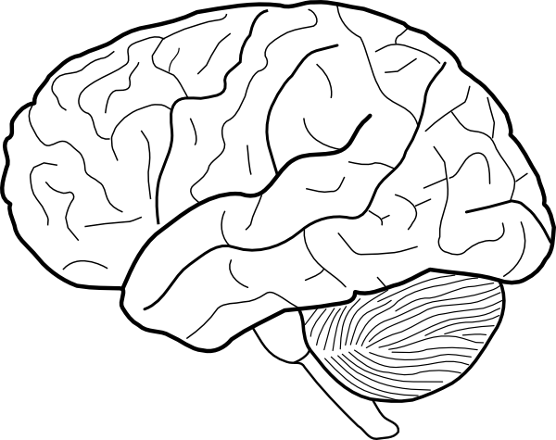
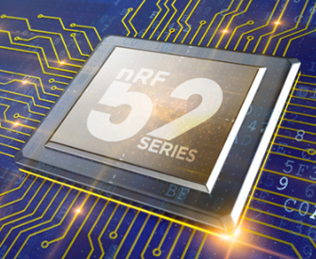
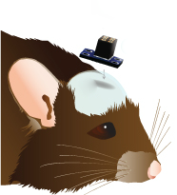
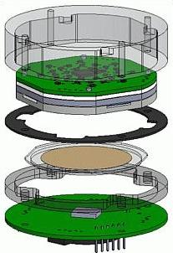
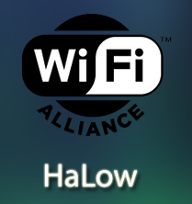
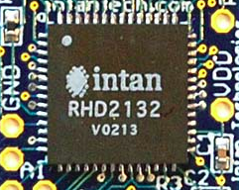

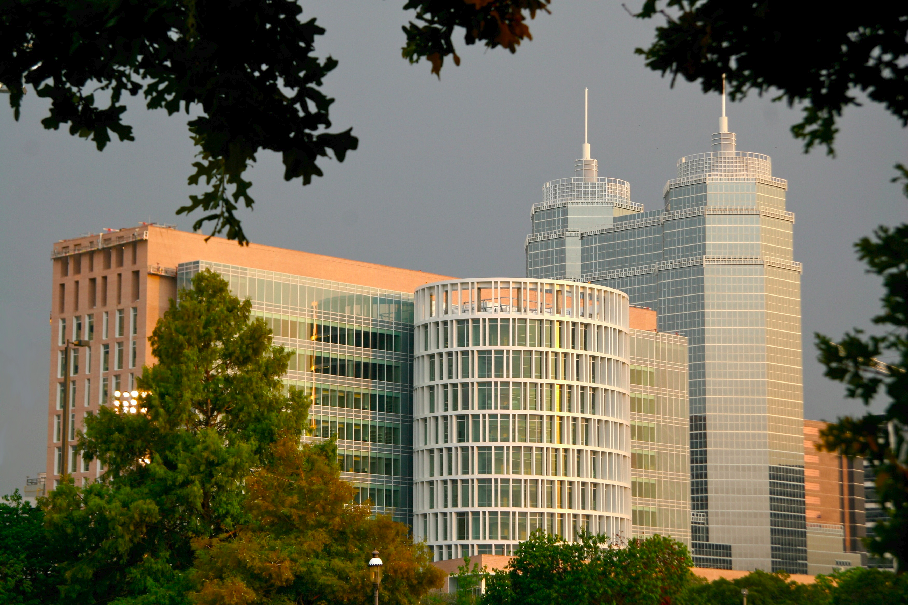

Energy-Efficient High-Throughput Wireless Transmission of Multi-Channel Neuro Signals
Yuan Gao, Xin Huang, Tingkai Liu, Stephen Xia
Department of Electrical and Computer Engineering, Rice University
Project Description
Engineering Design for a Single WNR Unit
Currently, no solution exists on the market for efficient recording of neural brain activity that is not restricted by a physical tether. Our goal is to develop a low-power, wireless, recording device that digitizes neural signals from a 16-channel, 16-element electrode array and sends that neural data securely and wirelessly to a portable receiver. The Wireless Neural Recorder (WNR) will be the embedded Electrocochleography (ECoG) solution that allows for wireless high-fidelity neural data transmission and recording.
Design Specifications
Neural Data
A2D Converter
ARM MicroProcessor
Bluetooth Low Energy
Recording Server
System Design Goal
Create a Compact, Power-Efficient, Wireless Add-on to Neural Electrode Arrays
16 Channels of Data
1K Samples/Sec
8 Bits of Data
Total: 128 Mbit/s
Intan RHD2132
Specialized Neural Recording with Protective Circuitry
NanoVolt Precision
Nordic NRF52
Powerful ARM Cortex-M4 Processor
Data Buffering and Compression
Nordic NRF52
128 bit AES encryption
1 Mbit/s Bandwidth
<6mA power consumption
Communicates with all WNR units
Neural Data Collection and Presentation
WNR Add-on Unit Specifications
Criteria | Target Value
Data Channels | 16 Channels
Data Precision | 8 Bits
Sampling Frequency | 1.0 kHz
Form Factor | 15 x 15 x 15 mm
Battery Life | 12 Hours
Prototype
Results
Everything is awesome
Everything is cool when you're part of a team
Everything is awesome
When we're living our dream
Everything is better when we stick together
Side by side
WNR + Neural Electrode Array
Array of 16 Neural Electrodes in brain
Each electrode outfitted with a WNR unit
Each WNR unit samples and processes neural data and transmits in real-time to a secure server
Next Steps
Begin small animal testing with functional prototype
Custom components: ideal fit of 8 x 8 x 8 mm
WiFi HaLow: Increase data rate beyond BLE products
Areas of Impact
Hospitals/Clinics
Research Institutions
Households
Acknowledgements
We would like to thank Rice ECE department members: Dr. Gary Woods, Dr. Aydin Babakhani, Hamed Rahmani and UTHealth Neurosurgeon: Dr. Nitin Tandon, for their technical advice and project support.
Special thanks to the Brenner Foundation with Ellen Kirk and the resources of the Oshman Engineering Design Kitchen. Without them, this project would not be possible.

